Slide 1
Implementation of the LIN protocol on a microcontroller-based device
Department of Computer Science
Faculty of Computer Science and Telecommunications
Politechnika Krakowska
Łukasz Rotko
Promoter: Ph.D. Eng. Jerzy Białas
Krakow 2023

Slide 2
1. Purpose and scope of work
Goal: Designing a device communicating using the LIN protocol
Scope:
LIN protocol
devices based on microcontrollers
Program that supports the device
Presentation of the operation of the complete device
Conclusions and possibilities of project development

Slide 3
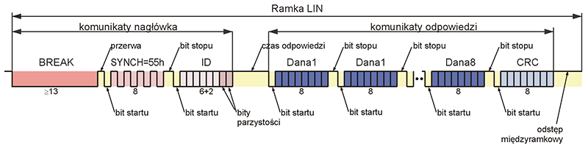
LIN protocol
Used in the automotive industry
Based on the UART protocol
Low implementation cost

Slide 4
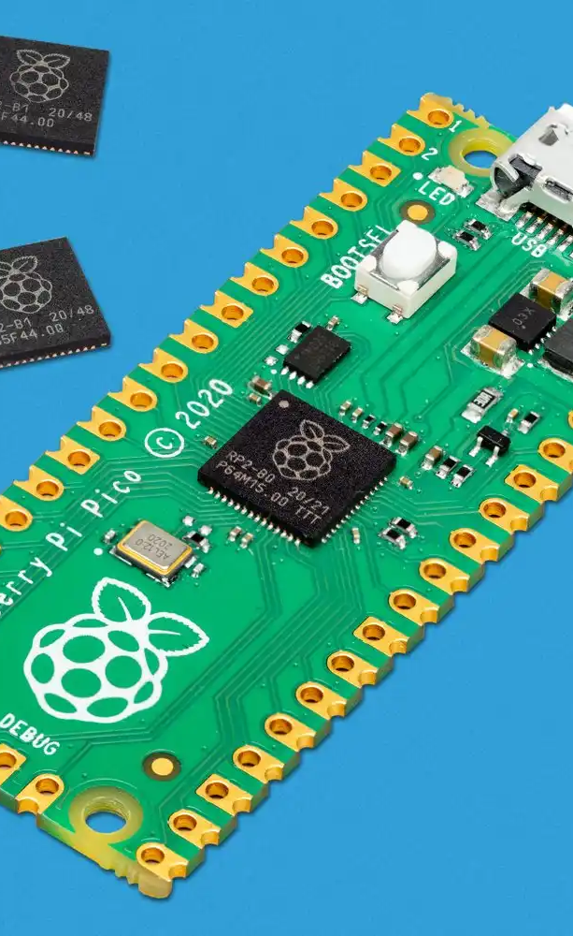
The device is based on a microcontroller
Board: RaspberryPi Pico
Small size and low price
Versatility in applications
Community support, documentation, Python libraries

Slide 5
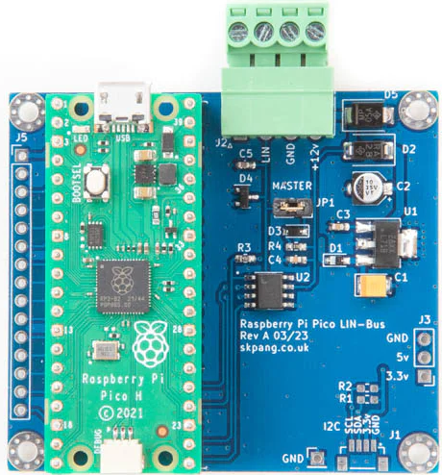
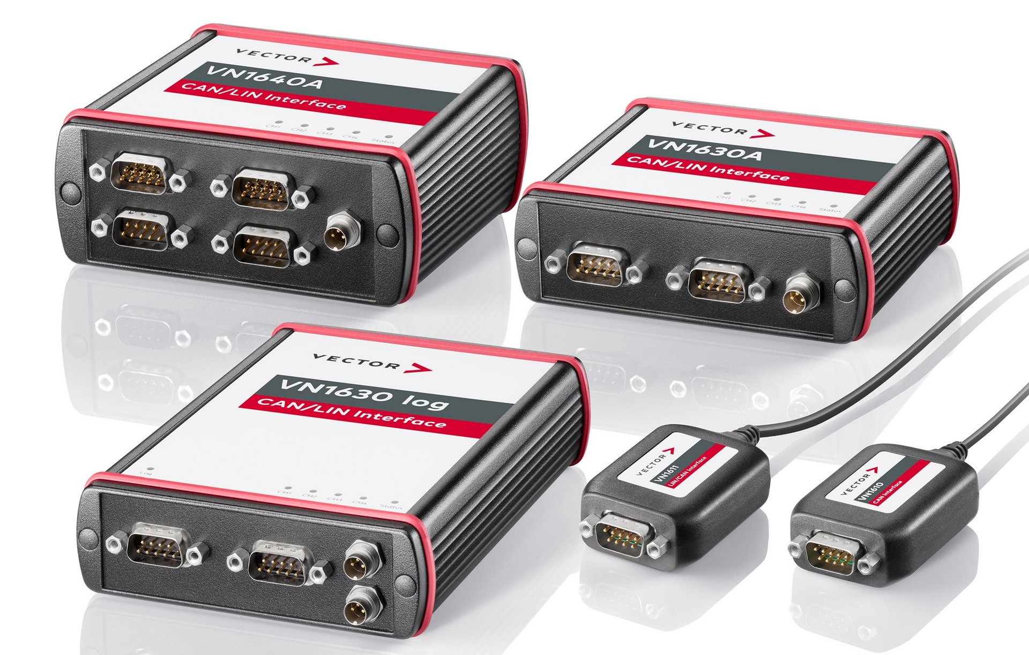
2. Similar devices
There are commercial devices designed for testing purposes
e.g. from the Vector company
There are shields for RaspberryPi Pico
No ready-made solutions or open source projects for RaspberryPi Pico and Micropython libraries

Slide 6
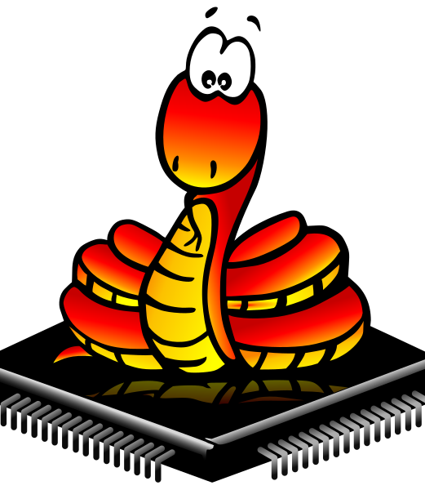
3. Software
Based on Python language and the MicroPython library
It consists of the main program that handles the protocol and additional scripts that facilitate work with the device
It uses state machines embedded in RaspberryPi Pico
Programming supported with ThonnyIDE and a ready-made solution for flashing - Rshell

Slide 7
4. Device operation
Import of a library containing functionality related to the protocol and ease of use
Preparing a script that defines the operating mode
Running the script that Flashes the device with the given instructions
Observation of communication through cmd console or as a dump of the event log to a file

Slide 8
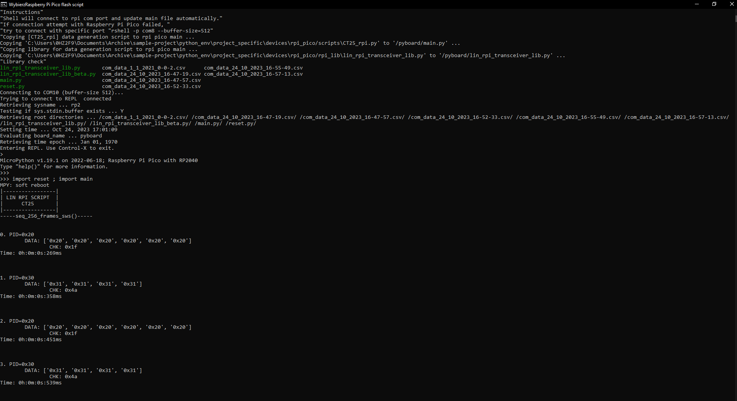

Slide 9
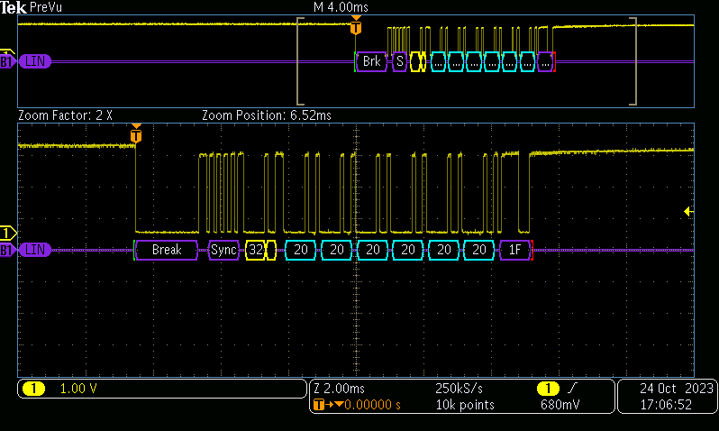

Slide 10

5. Sources and supporting materials
ISO standards or articles describing the structure of the LIN protocol
Documentation regarding RaspberryPi Pico and MicroPython libraries
Ready-made examples of using the board's capabilities in the form of OpenSource projects
Documentation for other technologies used (batch scripts and rshell)

Slide 11
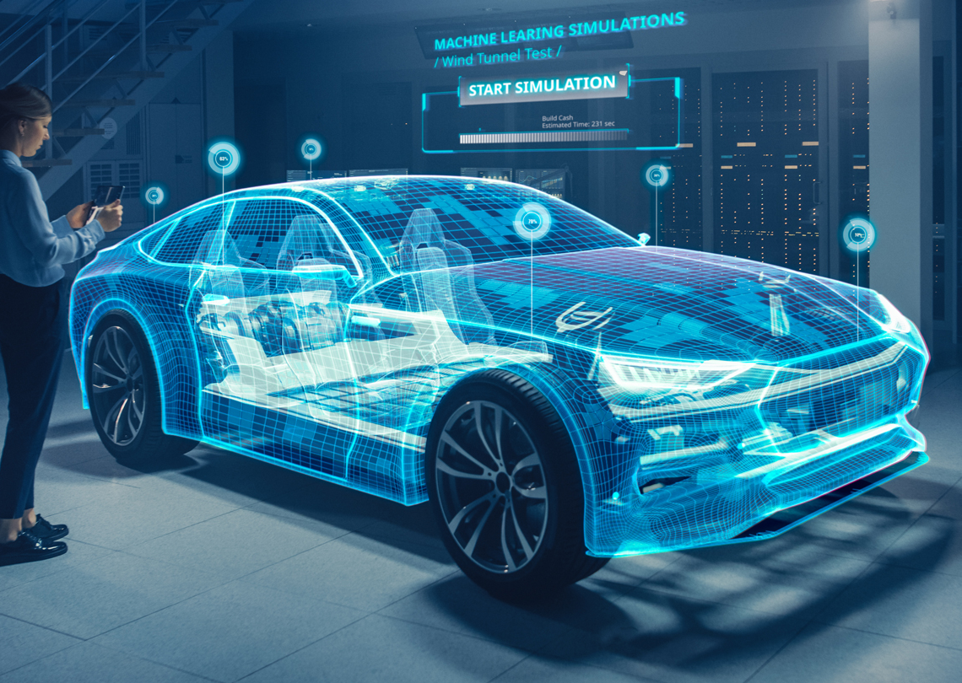
6. Application
Testing automotive devices
Significant cost reduction
Automation made easy
Easy adaptation of the device to a given field of testing
Integration with other devices via languagePython
Simulation of devices using the LIN protocol

Slide 12
Thank you for your attention
Photo sources:
https://www.vector.com/int/en/products/products-az/hardware/network-interfaces/successor-products/
https://en.wikipedia.org/wiki/File:Micropython-logo.svg
https://mikrokontroler.pl/2015/03/12/can-i-lin-analization-protokolow-szeregowych-oscyloskopami-rohdeschwarz-czesc-3/3/
https://www.nolato.com/en/Industries/Automotive
https://copperhilltech.com/raspberry-pi-pico-lin-bus-module/

